Slide 1
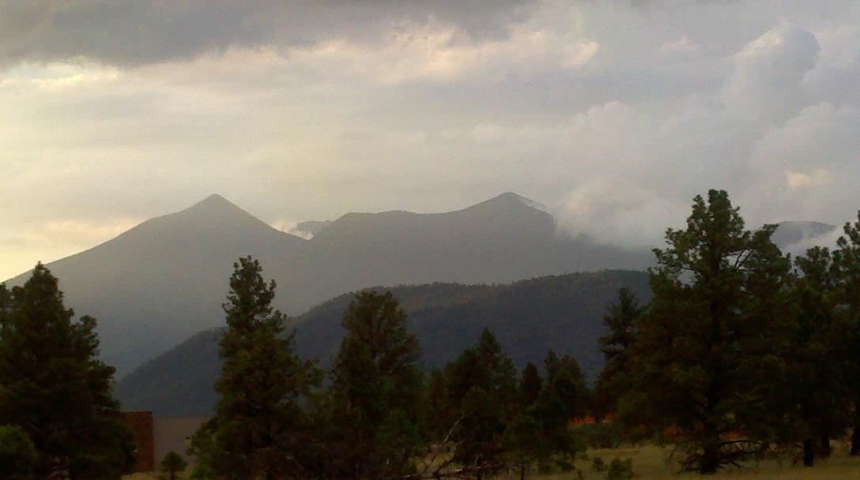


Ecological Snapshot of Beetle Distribution on an Elevation Gradient
Eric Kortenhoeven
Mentor: Dr. Neil Cobb
Hooper Undergraduate Research Award
(HURA)

Slide 2
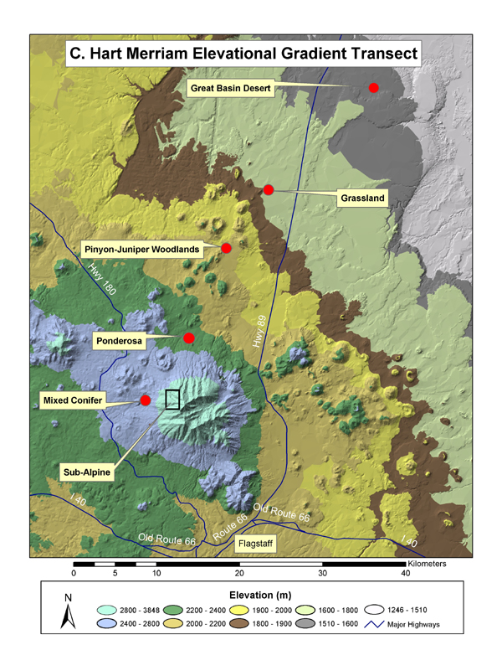
Introduction
Important tool to understand effects of Climate Change on biodiversity
Current distribution of species along an elevation gradient
Can be used in the future to track range shifts of organisms
In response to climate change
(Gobbi et al., 2007)
Distribution of beetles on the San Francisco Peaks in Northern Arizona
1783m-3021m

Slide 3
H₁-Temperature
H₁- There will be a decrease in species abundance and species richness as temperature decreases at higher elevation sites
(Merriam Powell Center for Environmental Research (MPCER))

Slide 4
H₂- Precipitation
H₂- There will be an increase in species abundance and species richness as precipitation increases at higher elevation sites
(Merriam Powell Center for Environmental Research (MPCER))

Slide 5
H₃- Narrow Niches
H₃- Most species will only occur in one habitat type, resulting in unique beetle communities arranged along gradient
Studies indicate that ground dwelling arthropods are highly responsive (Rainio and Niemela, 2003)
Changes in habitat (tree canopy vs intercanopy)
Disturbance
Species indicating habitat specificity (Rainio and Niemela, 2003)
More threatened by climate change impacts upon habitat

Slide 6
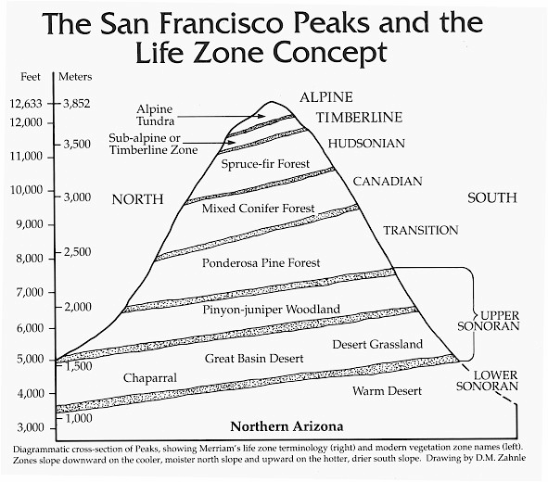
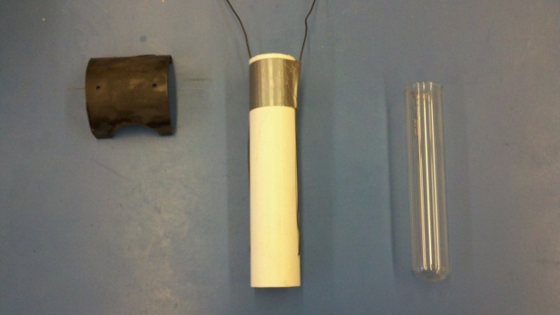
Methods
Pitfall traps were used to collect ground dwelling arthropods
4/7 life zones
6 distinct habitats
Grassland
Pinyon Juniper (PJ)
Ponderosa Pine Meadow (PIPO-O)
Ponderosa Pine Forested (PIPO-F)
Mixed Conifer Meadow (MC-O)
Mixed Conifer Forested (MC-F)
Pitfall trap

Slide 7
Diversity
H₁ Temperature- Supported in Species Richness
H₂ Precipitation-Unsupported in Species Richness
H₃ Narrow Niches - Not Applicable
85 species identified on the San Francisco Peaks Elevation Gradient
Grassland had highest diversity= 44 different species in that habitat

Slide 8
Abundance
H₁ Temperature- Supported in Overall Average Abundance lower sites
H₂ Precipitation-Supported in Overall Average Abundance
H₃ Narrow Niches - Not Applicable
Mixed Conifer Habitat dominated by Carabids
Mostly species: Synuchus dubius

Slide 9
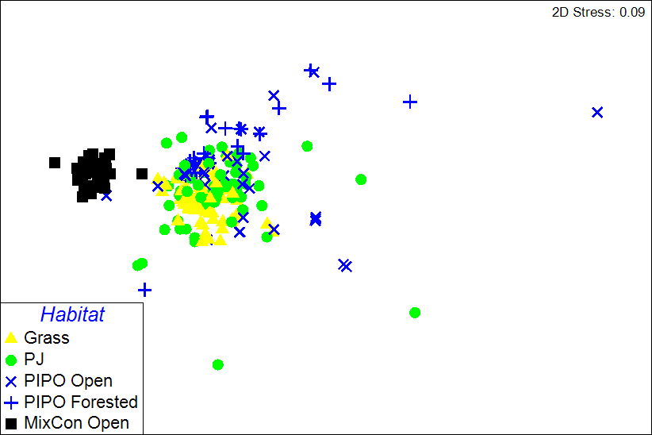
H₃ Narrow Niches- Supported- Unique beetle communities

Slide 10
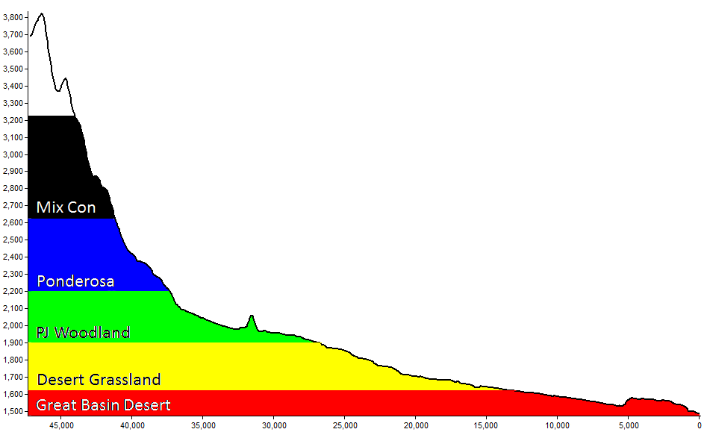
Elevation Profile
≈ 60% endemic
11
1
1
1
1
15
5
1
10
10
15
14
H₃ Narrow Niches- Supported- About 60% - Endemic- more threatened by climate change due to their specificity

Slide 11
Conclusion and Recommendations
Beetle community composition changes along the elevation gradient of the San Francisco Peaks
Lower Elevations- Dominated by Tenebrionidae
Upper Elevations- Dominated by Carabidae
60% of beetles found are endemic to specific habitats
Use the presence data to construct species distribution models (i.e. suitable habitat) for both present day and future climate change scenarios.

Slide 12
Thank You
NASA Space Grant
Dr. Nadine Barlow
Kathleen Stigmon
Hooper Undergraduate Research Award (HURA)
Dr. Neil Cobb- Mentor
Colorado Plateau Museum for Arthropod Biodiversity
Merriam-Powell Center for Environmental Research
Jacob Higgins- Curator
Emily Ellman- Field Volunteer

Slide 13

Questions?
Comments?

Slide 14
References
Gobbi, M., B. Rossaro, A. Vater, F. De Bernardi, M. Pelfini, and P. Brandmayr. 2007. Environmental features influencing Carabid beetle (Coleoptera) assemblages along a recently deglaciated area in the Alpine region. Ecological Entomology 32:682-689.
Hodkinson, I. D. 2005. Terrestrial insects along elevation gradients: species and community responses to altitude. Biological Reviews 80:489-513.
Rainio, J., & Niemela, J. (2003). Ground beetles ( Coleoptera : Carabidae ) as bioindicators, (McGeoch 1998), 487-506.

